Slide 1
Data Science Capstone Project IBM Data Science
Diogo Oliveira – March 2023
https://github.com/diogoolvra/IBMDSfilesdiogo/tree/main/Data%20Science%20and%20Machine%20Learning%20Capstone%20Project

Slide 2
Outline
01
02
Executive Summary
Introduction
03
04
Methodology
Results
05
06
Conclusions
Appendix

Slide 3
01
Executive Summary

Slide 4
Executive Summary
The following Methodology steps were followed:
Data Collection
Data Wrangling
Exploratory Data Analysis (EDA)
Interactive Visual Analytics
Predictive Analysis (Classification)
The following Results were produced:
Exploratory Data Analysis (EDA) results
Geospatial Analytics
Interactive Dashboard
Predictive Analysis of Classification Models

Slide 5
02
Introduction

Slide 6
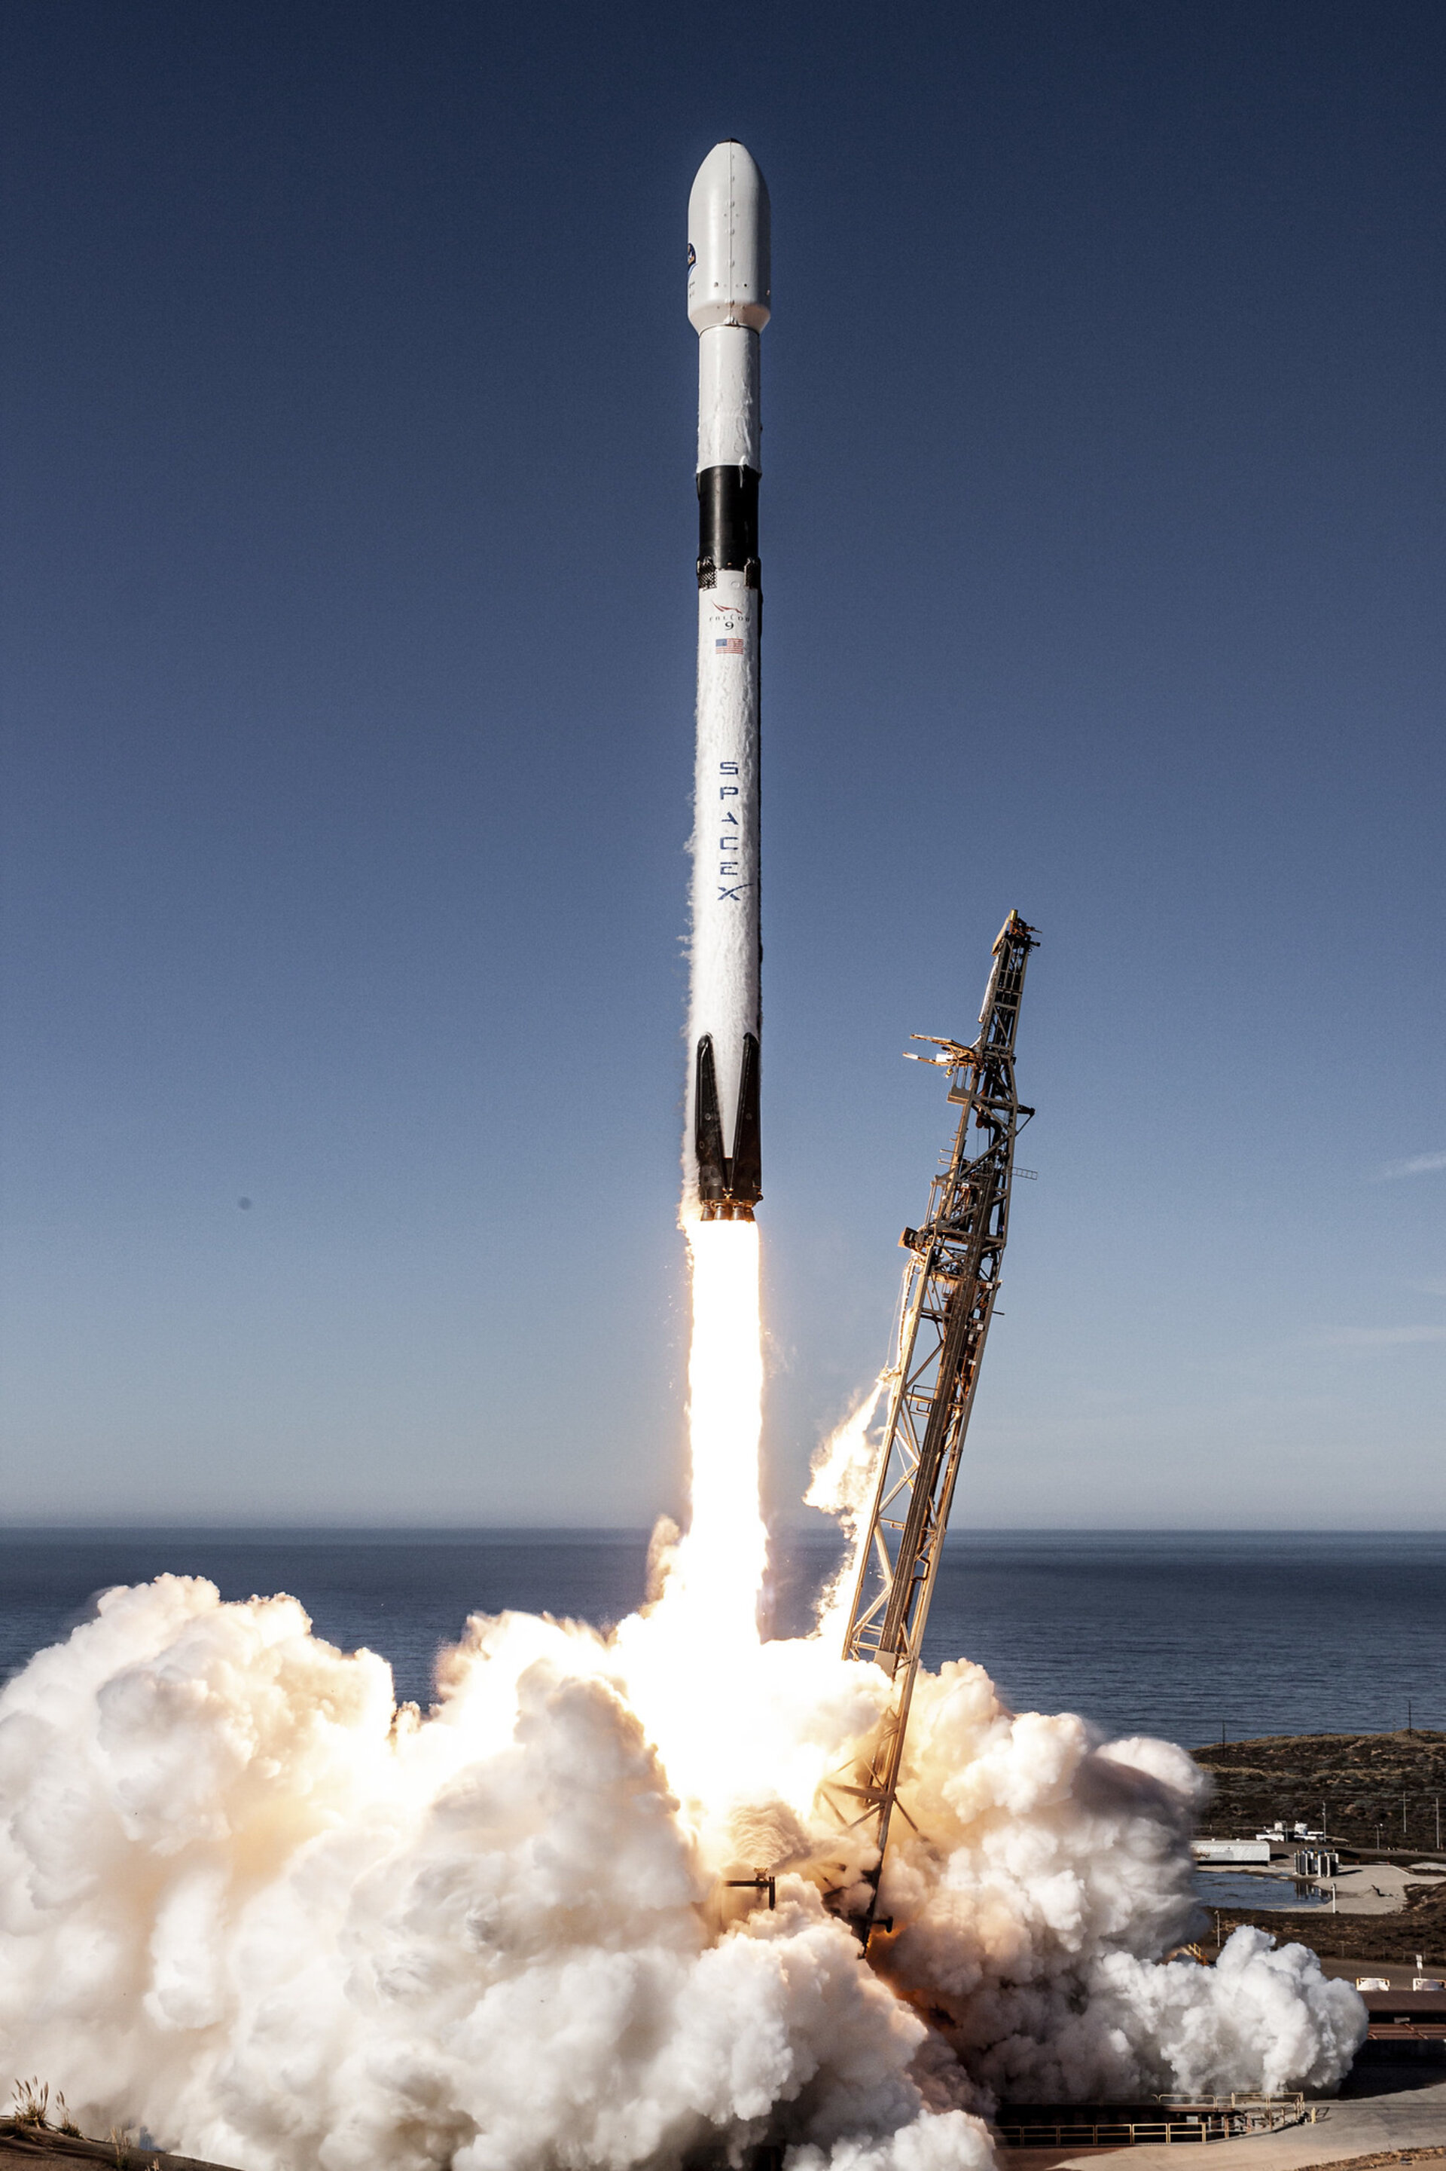
Introduction
SpaceX advertises Falcon 9 rocket launches on its website with a cost of 62 million dollars, while other providers cost upward of 165 million dollars each
Difference is due to the ability to reuse part of the rocket (Stage 1)
To bid against SpaceX for a rocket launch, it is necessary to determine if the first stage will land successfully
The company SpaceY wants to compete with SpaceX
Problem
SpaceY employs us to train a Machine Learning Model to predict successful Stage 1 landing and recovery.
SpaceX Falcon 9 Rocket - ESA

Slide 7
03
Methodology
Review of the methods used in:
Data Collection
Data Wrangling
Exploratory Data Analysis (EDA)
Interactive Visual Analytics
Predictive Analysis (Classification)

Slide 8
Methodology – Data Collection
A combination of API requests and Webscraping was used to collect the data for the next steps of the task.
The following slides will show flowcharts of the data collection process for both methods mentioned above.
Data available from each of the collection methods:
SpaceX API Data Columns
Wikipedia Webscape Data Columns
FlightNumber, Date, BoosterVersion, PayloadMass, Orbit, LaunchSite, Outcome, Flights, GridFins,
Reused, Legs, LandingPad, Block, ReusedCount, Serial, Longitude, Latitude
Flight No., Launch site, Payload, PayloadMass, Orbit, Customer, Launch outcome, Version Booster, Booster landing, Date, Time

Slide 9

Data Collection – SpaceX REST API
Request (SpaceX Rest API)
Convert the response to a .JSON file and then to a Pandas DataFrame using .json_normalize()
Dictionary relevant data
Create a Pandas DataFrame from the Dictionary Dataset
Filter DataFrame to only include Falcon 9 launches
Replace missing Payload Mass values with mean
https://github.com/diogoolvra/IBMDSfilesdiogo/blob/main/Data%20Science%20and%20Machine%20Learning%20Capstone%20Project/Module%201%20-%20Capstone%20Introduction%20and%20Understanding%20the%20Datasets/jupyter-labs-spacex-data-collection-api.ipynb

Slide 10
Data Collection – SpaceX Wikipedia Webscraping
Request (Wikipedia HTML)
Convert HTML response to BeautifulSoup object
Find all tables in HTML page and collect all collumn header names
Parse all launch tables into a Dictionary
Create a Pandas DataFrame from the Dictionary Dataset
https://github.com/diogoolvra/IBMDSfilesdiogo/blob/main/Data%20Science%20and%20Machine%20Learning%20Capstone%20Project/Module%201%20-%20Capstone%20Introduction%20and%20Understanding%20the%20Datasets/jupyter-labs-webscraping.ipynb

Slide 11
Methodology – Data Wrangling
‘Outcome’ collumn has two components:
Mission Outcome
Landing Location
A training label ‘Class’ was created, where the value equals 1 for a successful landing outcome and 0 if not.
The ‘Outcome’ to ‘Class’ values were mapped as follows:
True ADS, True RTLS, True Ocean – set to 1
None None, False ASDS, None ASDS, False Ocean, False RTLS – set to 0
https://github.com/diogoolvra/IBMDSfilesdiogo/blob/main/Data%20Science%20and%20Machine%20Learning%20Capstone%20Project/Module%201%20-%20Capstone%20Introduction%20and%20Understanding%20the%20Datasets/IBM-DS0321EN-SkillsNetwork_labs_module_1_L3_labs-jupyter-spacex-data_wrangling_jupyterlite.jupyterlite.ipynb

Slide 12
Methodology – EDA with Data Visualization
Exploratory Data Analysis with Data Visualization was performed to better understand the dynamics and relationships between different variables.
Plots visualized:
Flight Number vs. Payload Mass, Flight Number vs. Launch Site, Payload Mass vs. Launch Site, Orbit vs. Success Rate, Flight Number vs. Orbit, Payload vs Orbit, and Success Yearly Trend
Types of graphics used:
Scatter plots, line charts, and bar plots
https://github.com/diogoolvra/IBMDSfilesdiogo/blob/main/Data%20Science%20and%20Machine%20Learning%20Capstone%20Project/Module%202%20-%20Exploratory%20Data%20Analysis%20(EDA)/IBM-DS0321EN-SkillsNetwork_labs_module_2_jupyter-labs-eda-dataviz.ipynb.jupyterlite.ipynb

Slide 13
Methodology – EDA with SQL
Dataset was loaded into IBM DB2 Database and queried using SQL Python integration.
Different queries were made to have a better understanding of the data, including information about launch sites, pay loads, mission outcomes, landing outcomes, and others.
https://github.com/diogoolvra/IBMDSfilesdiogo/blob/main/Data%20Science%20and%20Machine%20Learning%20Capstone%20Project/Module%202%20-%20Exploratory%20Data%20Analysis%20(EDA)/jupyter-labs-eda-sql-edx_sqllite.ipynb

Slide 14
Methodology – Folium Interactive Analytics
Folium library was used to visualize the launch data on an interactive map.
The following steps were taken:
All launch sites were marked
All the successful/failed launches for each site were marked.
Distance between launch sites and key locations was calculated and marked.
https://github.com/diogoolvra/IBMDSfilesdiogo/blob/main/Data%20Science%20and%20Machine%20Learning%20Capstone%20Project/Module%203%20-%20Interactive%20Visual%20Analytics%20and%20Dashboard/IBM-DS0321EN-SkillsNetwork_labs_module_3_lab_jupyter_launch_site_location.jupyterlite.ipynb

Slide 15
Methodology – Plotly Dash Interactive Dashboard
The following plots were added to a Plotly Dash to get an interactive visualization of the data:
Pie chart (px.pie( )) for the total successful lauches per site.
Scatter graph (px.scatter( )) to show the relation between the Payload Mass and the outcome. The results are shown for all or individually chosen launch sites. A slider allows Payload Mass between 0 and 10000 kg.
https://github.com/diogoolvra/IBMDSfilesdiogo/blob/main/Data%20Science%20and%20Machine%20Learning%20Capstone%20Project/Module%203%20-%20Interactive%20Visual%20Analytics%20and%20Dashboard/spacex_dash_app.py

Slide 16
Methodology – Predictive Analysis (Classification)
Model Development
Model Evaluation
Model Conclusions
Load Dataset
Standadise and Preprocess Data
Split Data into training and testing data sets
For chosen algorithm:
Create a GridSearchCV object and parameter dictionary
Fit object to parameters
Train model using training data set
For chosen algorithm:
For output of GridSearchCV object check the tuned hyperparameters and accuracy
Predict the testing data set using the tuned model and hyperparameters
Check the accuracy of the model for the testing data set
Plot and examine Confusion Matrix
Review the accuracy scores for all algorithms
Determine the best model by analyzing accuracy scores and confusion matrixes.
https://github.com/diogoolvra/IBMDSfilesdiogo/blob/main/Data%20Science%20and%20Machine%20Learning%20Capstone%20Project/Module%204%20-%20Predictive%20Analysis%20(Classification)/IBM-DS0321EN-SkillsNetwork_labs_module_4_SpaceX_Machine_Learning_Prediction_Part_5.jupyterlite.ipynb

Slide 17
04
Results
Obtained in
Exploratory Data Analysis (EDA)
Interactive Visual Analytics
Predictive Analysis (Classification)

Slide 18
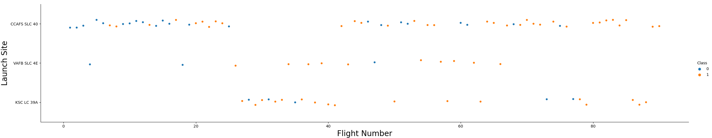
Results – EDA with Visualization
Flight Number vs. Launch Site
Successful Outcome
Unsuccessful Outcome
Success rate increased overtime.
Around Flight nr. 20 the success rate increased significantly, likely due to upgrades.
CCAFS SLC 40 seems to be the main lauch and testing site due to volume of launches and the higher rate of unsuccessful outcomes.
https://github.com/diogoolvra/IBMDSfilesdiogo/blob/main/Data%20Science%20and%20Machine%20Learning%20Capstone%20Project/Module%202%20-%20Exploratory%20Data%20Analysis%20(EDA)/IBM-DS0321EN-SkillsNetwork_labs_module_2_jupyter-labs-eda-dataviz.ipynb.jupyterlite.ipynb

Slide 19
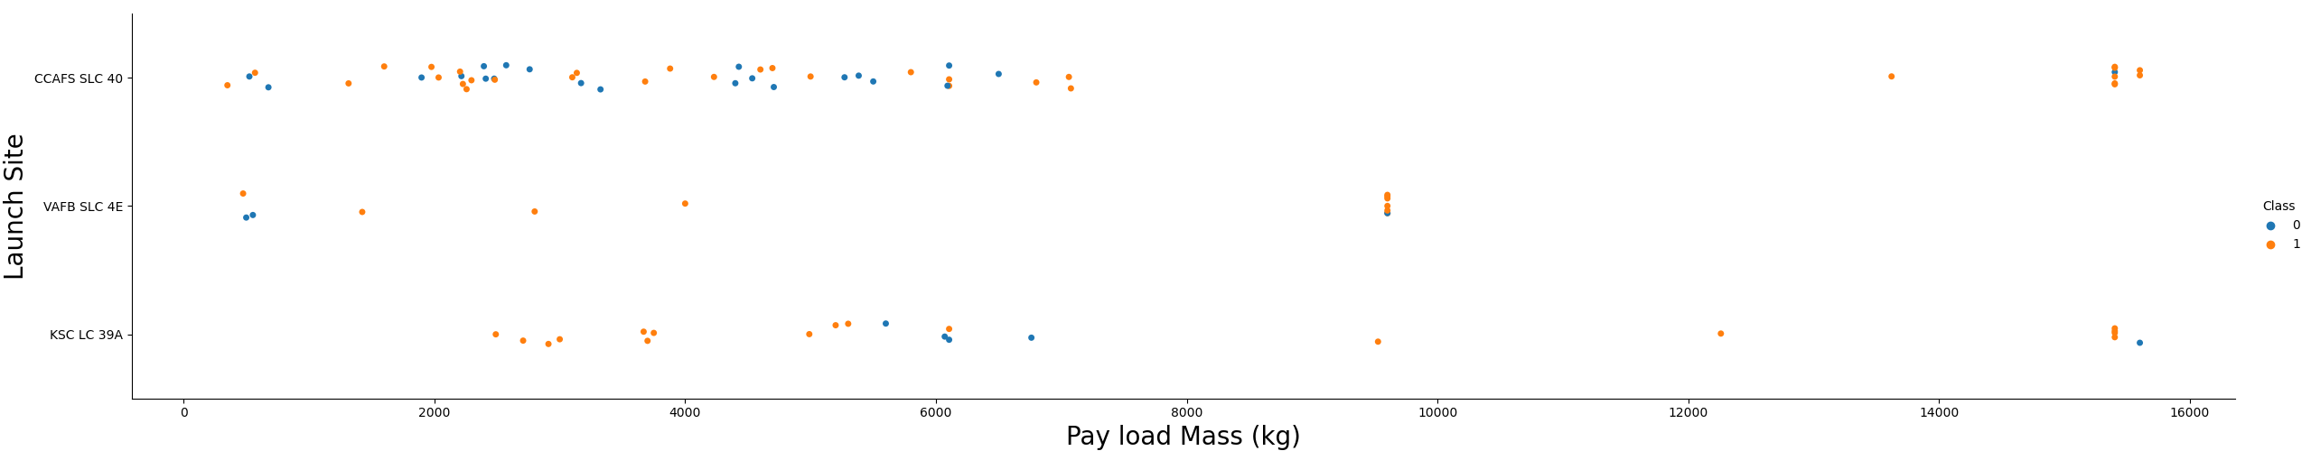
Results – EDA with Visualization
Payload Mass vs. Launch Site
Successful Outcome
Unsuccessful Outcome
Payload Mass appears to fall mostly between 0 and 7000 kg.
VAFB SLC 4E seems to be unable to host lauches with heavy payload, which is not the case for the other launch sites.
https://github.com/diogoolvra/IBMDSfilesdiogo/blob/main/Data%20Science%20and%20Machine%20Learning%20Capstone%20Project/Module%202%20-%20Exploratory%20Data%20Analysis%20(EDA)/IBM-DS0321EN-SkillsNetwork_labs_module_2_jupyter-labs-eda-dataviz.ipynb.jupyterlite.ipynb

Slide 20
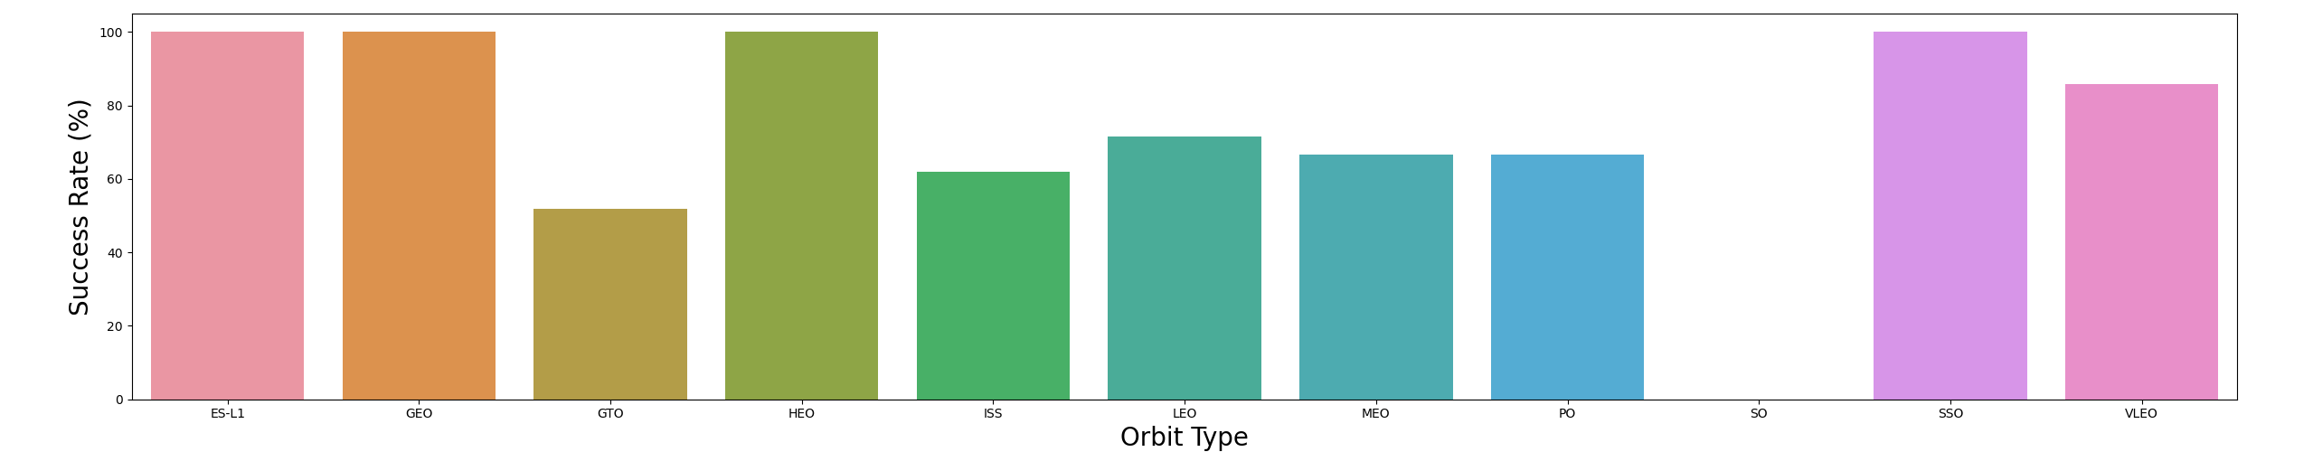
Results – EDA with Visualization
Payload Mass vs. Launch Site
1
1
5
1
21
7
3
9
1
5
14
ES-L1 (Earth-Sun First Lagrangion Point), GEO (Geostationary Orbit), HEO (High Earth Orbit), and SSO (Sun-synchronous Orbit) have 100% success (or landing) rate, although only SSO has a relevant number of samples.
SO (Heliocentric Orbit) has 0% success rate.
ISS (International Space Station) and VLEO (Very Low Earth Orbit) are the most common type of orbit.
https://github.com/diogoolvra/IBMDSfilesdiogo/blob/main/Data%20Science%20and%20Machine%20Learning%20Capstone%20Project/Module%202%20-%20Exploratory%20Data%20Analysis%20(EDA)/IBM-DS0321EN-SkillsNetwork_labs_module_2_jupyter-labs-eda-dataviz.ipynb.jupyterlite.ipynb

Slide 21
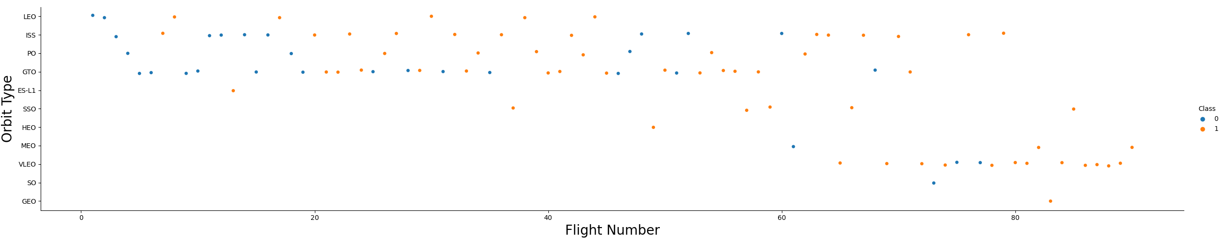
Results – EDA with Visualization
Flight Number vs. Orbit Type
Successful Outcome
Unsuccessful Outcome
Orbit type preference changed over Flight Number, from LEO, ISS, PO, and GTO to VLEO in the most recent launches.
Excluding the outcome rate of the first 20 lauches, the Falcon 9 appears to perform well on lower orbits.
https://github.com/diogoolvra/IBMDSfilesdiogo/blob/main/Data%20Science%20and%20Machine%20Learning%20Capstone%20Project/Module%202%20-%20Exploratory%20Data%20Analysis%20(EDA)/IBM-DS0321EN-SkillsNetwork_labs_module_2_jupyter-labs-eda-dataviz.ipynb.jupyterlite.ipynb

Slide 22
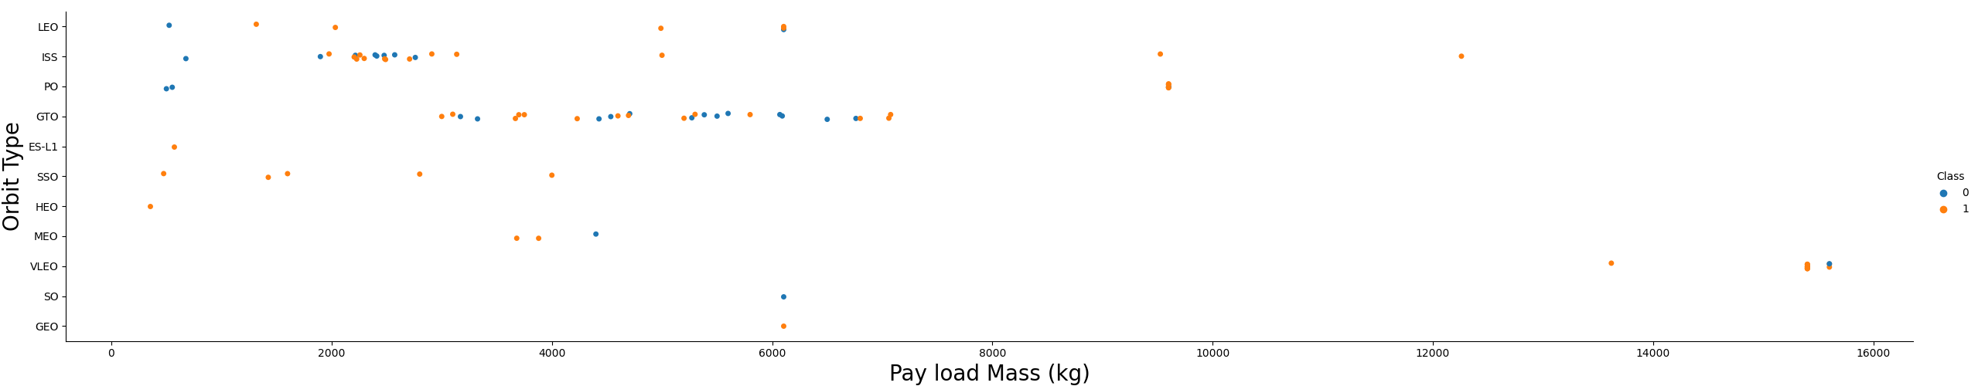
Results – EDA with Visualization
Payload Mass vs. Orbit Type
Successful Outcome
Unsuccessful Outcome
Orbit types have specific payload mass range, so the two variables correlate, as expected.
VLEO orbits require the highest amount of payload mass, almost double than most other orbit types.
For orbits like LEO, ISS, PO, and GTO, an increased payload mass improves the success rate.
https://github.com/diogoolvra/IBMDSfilesdiogo/blob/main/Data%20Science%20and%20Machine%20Learning%20Capstone%20Project/Module%202%20-%20Exploratory%20Data%20Analysis%20(EDA)/IBM-DS0321EN-SkillsNetwork_labs_module_2_jupyter-labs-eda-dataviz.ipynb.jupyterlite.ipynb

Slide 23
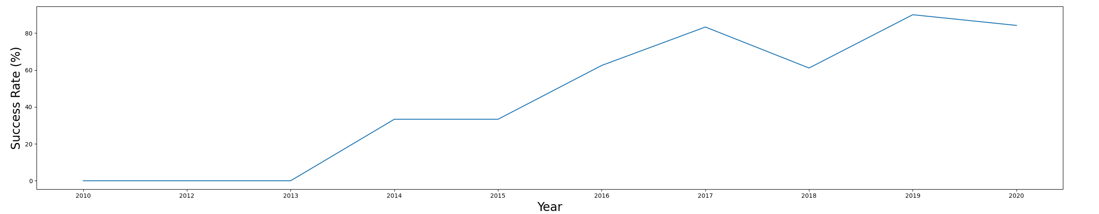
Results – EDA with Visualization
Success Rate Yearly Trend
Successful Outcome
Unsuccessful Outcome
Success rate has improved significantly over the years to about 80% in recent years.
The year 2019 was the most successful so far, with about 90% success rate.
https://github.com/diogoolvra/IBMDSfilesdiogo/blob/main/Data%20Science%20and%20Machine%20Learning%20Capstone%20Project/Module%202%20-%20Exploratory%20Data%20Analysis%20(EDA)/IBM-DS0321EN-SkillsNetwork_labs_module_2_jupyter-labs-eda-dataviz.ipynb.jupyterlite.ipynb

Slide 24
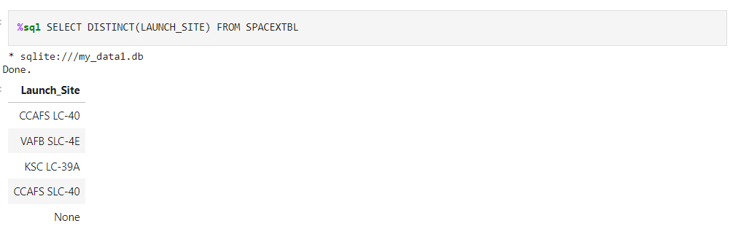
Results – EDA with SQL
Display the names of the unique launch sites in the space mission
CCAFS SLC-40 and CCAFS LC-40 likely represent the same lauch site.
CCAFS SLC-40, KSC LC-39A, VAFB SLC-4E are the 3 unique lauch site locations
https://github.com/diogoolvra/IBMDSfilesdiogo/blob/main/Data%20Science%20and%20Machine%20Learning%20Capstone%20Project/Module%202%20-%20Exploratory%20Data%20Analysis%20(EDA)/jupyter-labs-eda-sql-edx_sqllite.ipynb

Slide 25
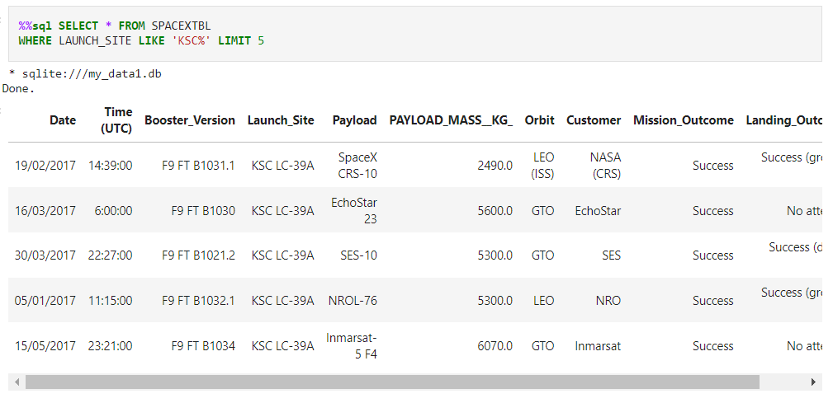
Results – EDA with SQL
Display 5 records where launch sites begin with the string 'KSC'
https://github.com/diogoolvra/IBMDSfilesdiogo/blob/main/Data%20Science%20and%20Machine%20Learning%20Capstone%20Project/Module%202%20-%20Exploratory%20Data%20Analysis%20(EDA)/jupyter-labs-eda-sql-edx_sqllite.ipynb

Slide 26
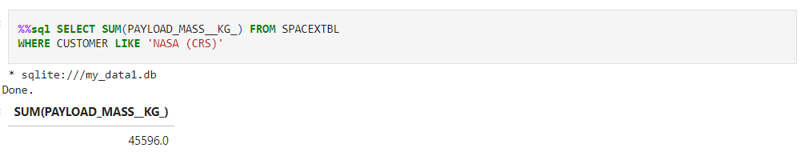
Results – EDA with SQL
Display the total payload mass carried by boosters launched by NASA (CRS)
This query summs up the total payload mass (kg) of launches where NASA was the costumer.
CRS (Commercial Resupply Services) meas that these payloads were likely sent to the ISS.
https://github.com/diogoolvra/IBMDSfilesdiogo/blob/main/Data%20Science%20and%20Machine%20Learning%20Capstone%20Project/Module%202%20-%20Exploratory%20Data%20Analysis%20(EDA)/jupyter-labs-eda-sql-edx_sqllite.ipynb

Slide 27
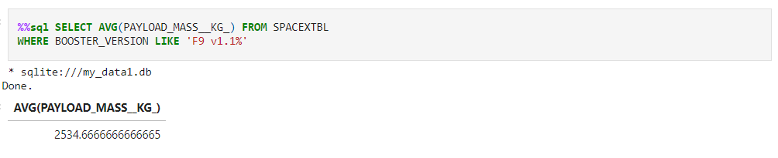
Results – EDA with SQL
Display average payload mass carried by booster version F9 v1.1
This query calculates the average payload mass (kg) carried by rockets using the booster version F9 v1.1 .
The average payload value sits on the lower end of the payload mass range, considering other launches can get close to 16000 kg.
https://github.com/diogoolvra/IBMDSfilesdiogo/blob/main/Data%20Science%20and%20Machine%20Learning%20Capstone%20Project/Module%202%20-%20Exploratory%20Data%20Analysis%20(EDA)/jupyter-labs-eda-sql-edx_sqllite.ipynb

Slide 28
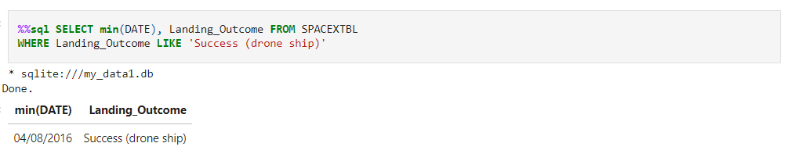
Results – EDA with SQL
List the date where the successful landing outcome in drone ship was acheived
This query returns the date where the first successful drone ship landing was achieved.
Despite the first successful landings appeared in 2014, only on the 8th of April 2016 did SpaceX successfully land the first stage in a drone ship.
https://github.com/diogoolvra/IBMDSfilesdiogo/blob/main/Data%20Science%20and%20Machine%20Learning%20Capstone%20Project/Module%202%20-%20Exploratory%20Data%20Analysis%20(EDA)/jupyter-labs-eda-sql-edx_sqllite.ipynb

Slide 29
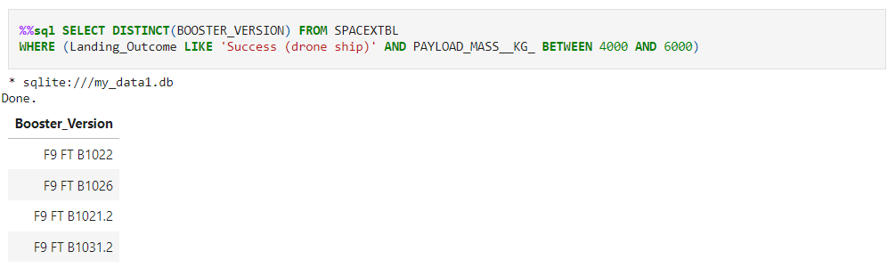
Results – EDA with SQL
List the names of the boosters which have success in ground pad and have payload mass greater than 4000 but less than 6000
https://github.com/diogoolvra/IBMDSfilesdiogo/blob/main/Data%20Science%20and%20Machine%20Learning%20Capstone%20Project/Module%202%20-%20Exploratory%20Data%20Analysis%20(EDA)/jupyter-labs-eda-sql-edx_sqllite.ipynb

Slide 30
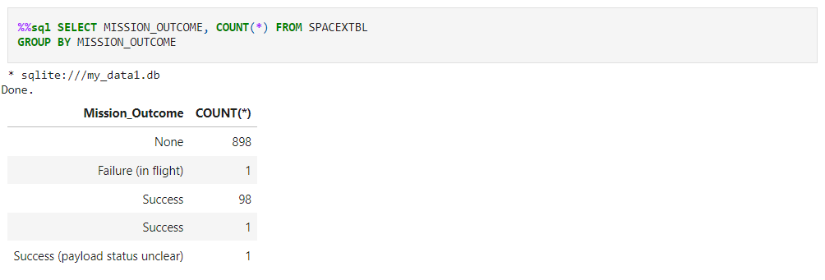
Results – EDA with SQL
List the total number of successful and failure mission outcomes
SpaceX achieves its mission outcome nearly 99% of the time, which means most the landing failures are intentional or at least expected.
As there aren’t 1000 different flights in the database, the 898 ‘none’ values are irrelevant, incorrect and likely a problem with the source database.
https://github.com/diogoolvra/IBMDSfilesdiogo/blob/main/Data%20Science%20and%20Machine%20Learning%20Capstone%20Project/Module%202%20-%20Exploratory%20Data%20Analysis%20(EDA)/jupyter-labs-eda-sql-edx_sqllite.ipynb

Slide 31
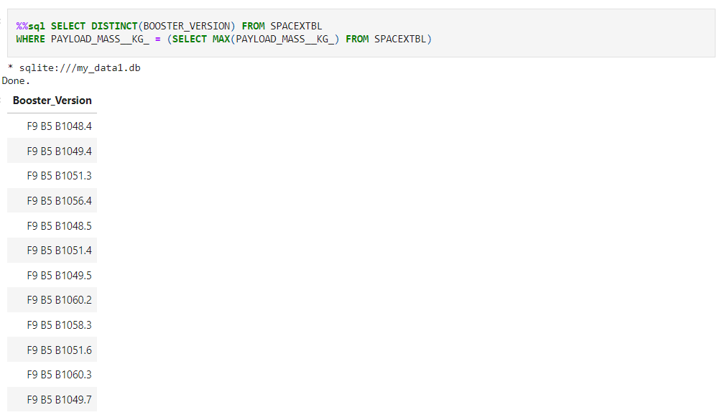
Results – EDA with SQL
List the names of the booster_versions which have carried the maximum payload mass. Use a subquery
12 different booster version of the F9 B5 B10 variety carried the highest payload mass registered until now with 15600 kg.
https://github.com/diogoolvra/IBMDSfilesdiogo/blob/main/Data%20Science%20and%20Machine%20Learning%20Capstone%20Project/Module%202%20-%20Exploratory%20Data%20Analysis%20(EDA)/jupyter-labs-eda-sql-edx_sqllite.ipynb

Slide 32
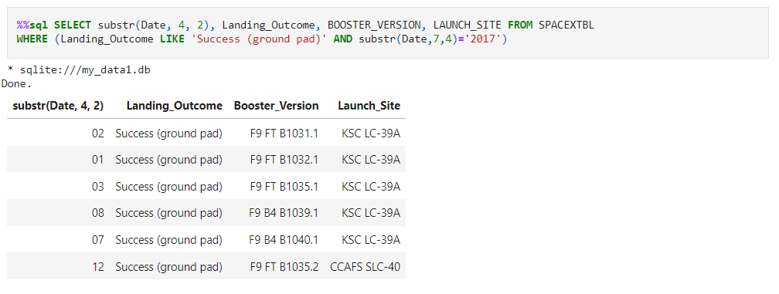
Results – EDA with SQL
List the records which will display the month names, succesful landing_outcomes in ground pad ,booster versions, launch_site for the months in year 2017
For the year 2017, there were successfull landing outcomes in the months of January, February, March, July, August and December, all for different booster versions and across two lauch sites, KSC-LC-39 for the first 5 launches and CCAFS SLC -40 for the last one.
https://github.com/diogoolvra/IBMDSfilesdiogo/blob/main/Data%20Science%20and%20Machine%20Learning%20Capstone%20Project/Module%202%20-%20Exploratory%20Data%20Analysis%20(EDA)/jupyter-labs-eda-sql-edx_sqllite.ipynb

Slide 33
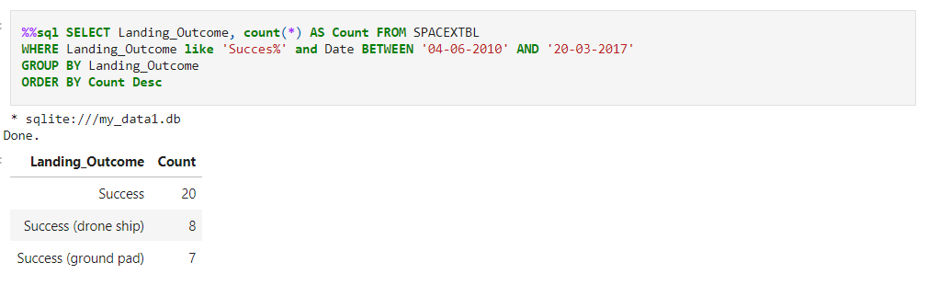
Results – EDA with SQL
Rank the count of successful landing_outcomes between the date 04-06-2010 and 20-03-2017 in descending order.
Excluding the ‘Success’ undetailed landing outcomes.
There were a total of 15 successful landing outcomes for the given time frame, 8 of them achieve in a drone ship and 7 of them on a ground pad
https://github.com/diogoolvra/IBMDSfilesdiogo/blob/main/Data%20Science%20and%20Machine%20Learning%20Capstone%20Project/Module%202%20-%20Exploratory%20Data%20Analysis%20(EDA)/jupyter-labs-eda-sql-edx_sqllite.ipynb

Slide 34
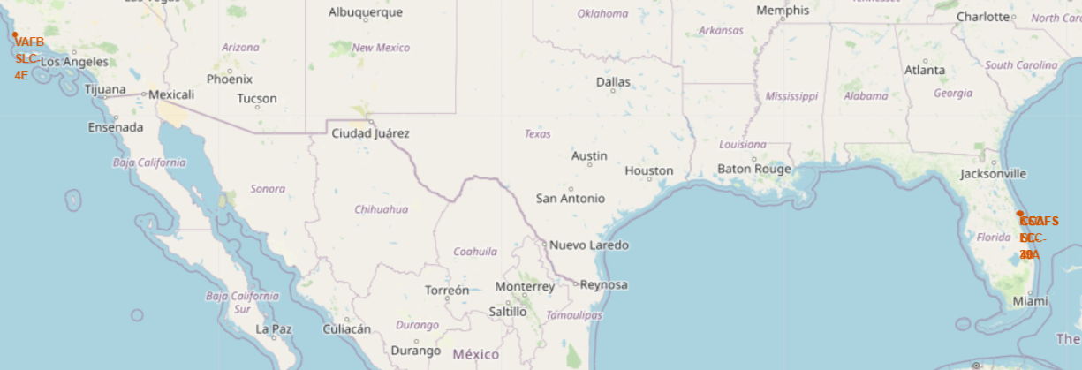
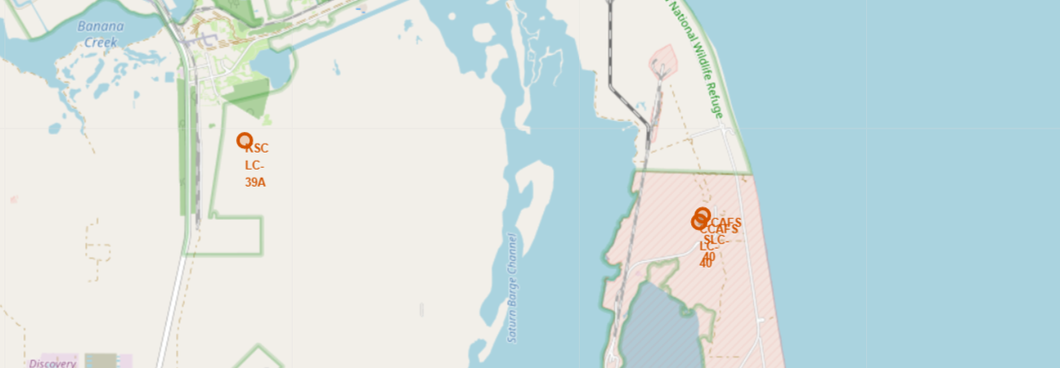
Results – Interactive Map with Folium
Lauch Site Locations
First figure shows the locations of all launch sites.
Second figure depicts the locations of the Florida lauch sites.
All lauch sites are close to the ocean, as it is safer in case of malfunction.
All lauch sites are also far from civilization and inside heavely guarded locations.
https://github.com/diogoolvra/IBMDSfilesdiogo/blob/main/Data%20Science%20and%20Machine%20Learning%20Capstone%20Project/Module%203%20-%20Interactive%20Visual%20Analytics%20and%20Dashboard/IBM-DS0321EN-SkillsNetwork_labs_module_3_lab_jupyter_launch_site_location.jupyterlite.ipynb

Slide 35
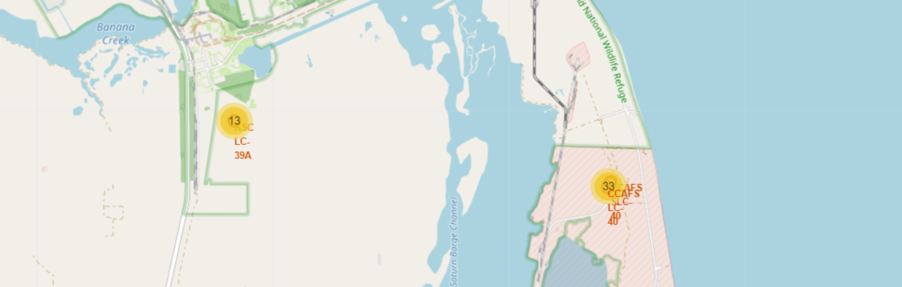
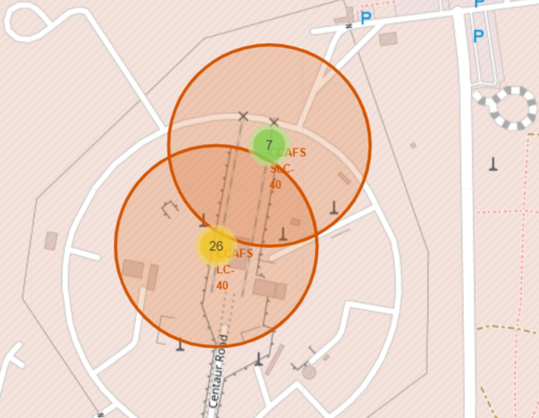
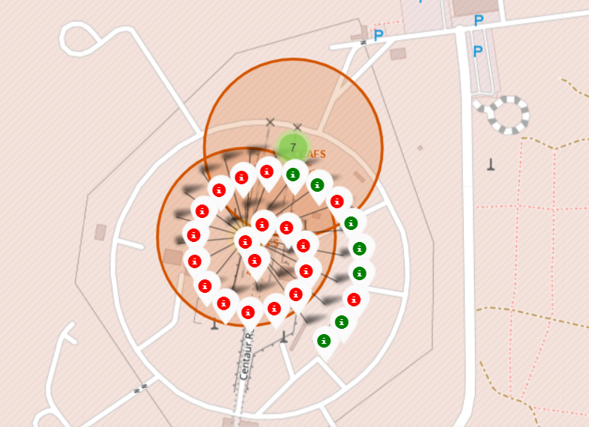
Results – Interactive Map with Folium
Color-Coded Launch Markers
More information was added to the markers, including number of lauches for each launch site and color-coded markers indicating the successfullness of landings for each launch in the specific launch site.
As an example, for the launch site CCAFS LC-40 there have been 7 successful landings and 19 unsuccessful landings.
https://github.com/diogoolvra/IBMDSfilesdiogo/blob/main/Data%20Science%20and%20Machine%20Learning%20Capstone%20Project/Module%203%20-%20Interactive%20Visual%20Analytics%20and%20Dashboard/IBM-DS0321EN-SkillsNetwork_labs_module_3_lab_jupyter_launch_site_location.jupyterlite.ipynb

Slide 36
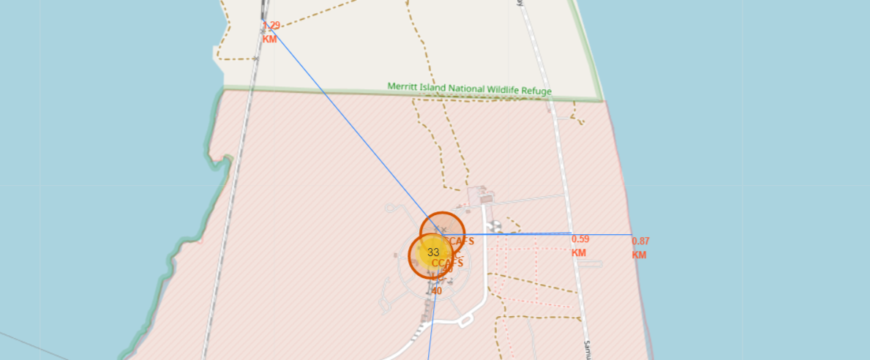
Results – Interactive Map with Folium
Key-Location Proximity
The distance to key locations was also plotted in the interactive map for more information.
The locations include raylways and highways for supply reasons, the closest city and the coast.
https://github.com/diogoolvra/IBMDSfilesdiogo/blob/main/Data%20Science%20and%20Machine%20Learning%20Capstone%20Project/Module%203%20-%20Interactive%20Visual%20Analytics%20and%20Dashboard/IBM-DS0321EN-SkillsNetwork_labs_module_3_lab_jupyter_launch_site_location.jupyterlite.ipynb

Slide 37
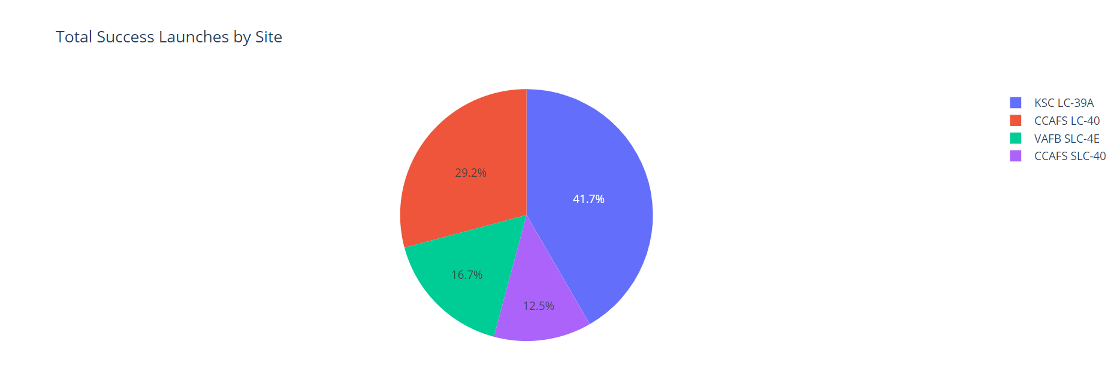
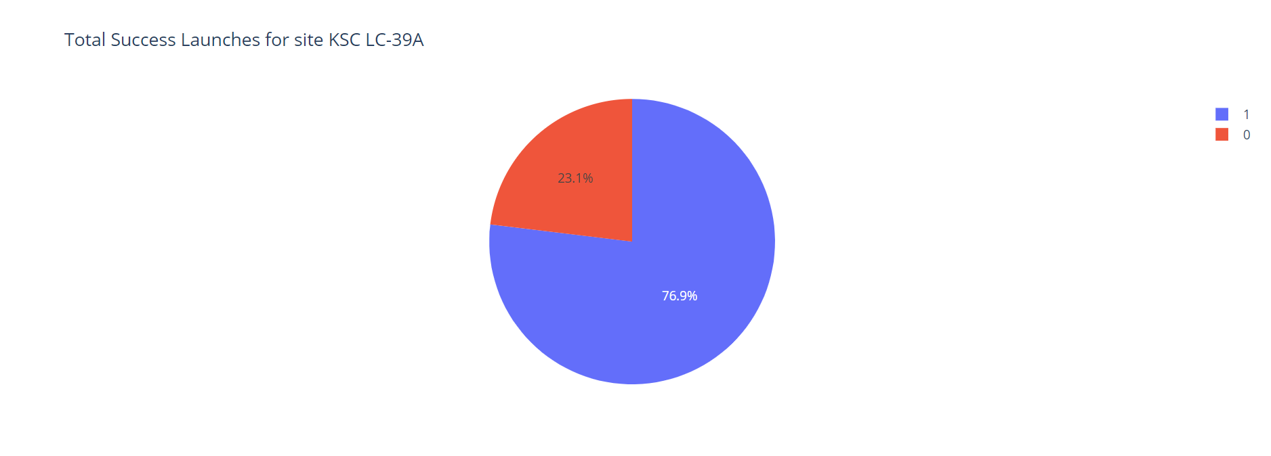
Results – Plotly Dash Interactive Dashboard
Successful Landing Across Launch Sites
First figure depicts the landing success rate for all launch sites.
KSC LC-39 A had the most successful launches, with 41.7% of the total successful landings.
Second figure depicts the landing success rate of the most successful lauch site KSC LC-39, with 76.9% success rate.
https://github.com/diogoolvra/IBMDSfilesdiogo/blob/main/Data%20Science%20and%20Machine%20Learning%20Capstone%20Project/Module%203%20-%20Interactive%20Visual%20Analytics%20and%20Dashboard/spacex_dash_app.py

Slide 38
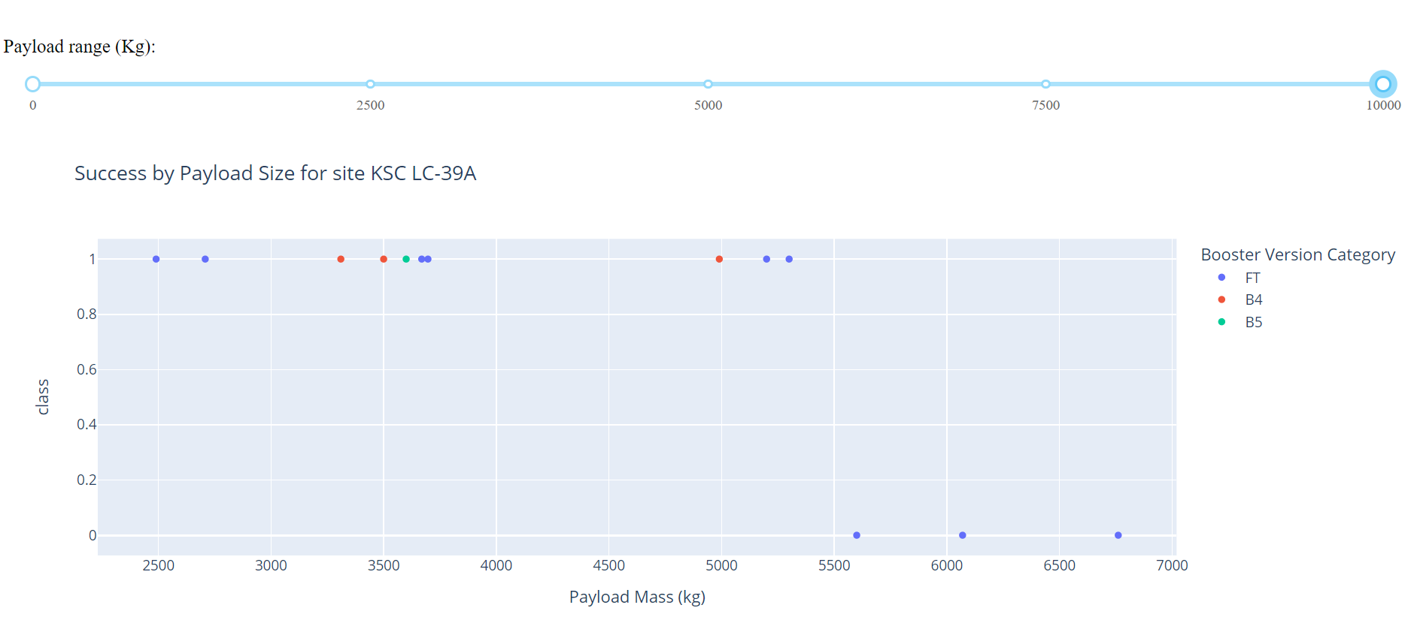
Results – Plotly Dash Interactive Dashboard
Payload Mass vs. Success vs. Booster Version Category
Plotly dashboard has a Payload range selector, in this case, from 0-10000 kg. Class indicates 1 for successful landing and 0 for failure. Scatter plot also accounts for booster version category in color and number of launches in point size.
Following last slide’s case, KSC LC-39 A, we can now see the payload mass values associated with each lauch and their individual outcome.
For KSC LC-39 A, we can see that all unsuccessful landings (3) were flights with payload mass above 5500 kg, while all flights below this value were successfully landed (10).
https://github.com/diogoolvra/IBMDSfilesdiogo/blob/main/Data%20Science%20and%20Machine%20Learning%20Capstone%20Project/Module%203%20-%20Interactive%20Visual%20Analytics%20and%20Dashboard/spacex_dash_app.py

Slide 39
Results – Predictive Analysis (Classification)
Classification Accuracy
Algorithm | Accuracy Score (%)
Logistic Regression | 83.33 %
Support Vector Machine | 83.33 %
Decision Tree | 83.33 %
K Nearest Neighbours | 83.33 %
All models have the same accuracy score on the test sample, with 83.33%.
These results lose relevance considering that the test sample size is only 18.
For more definitive results a larger test sample is needed.
https://github.com/diogoolvra/IBMDSfilesdiogo/blob/main/Data%20Science%20and%20Machine%20Learning%20Capstone%20Project/Module%204%20-%20Predictive%20Analysis%20(Classification)/IBM-DS0321EN-SkillsNetwork_labs_module_4_SpaceX_Machine_Learning_Prediction_Part_5.jupyterlite.ipynb

Slide 40
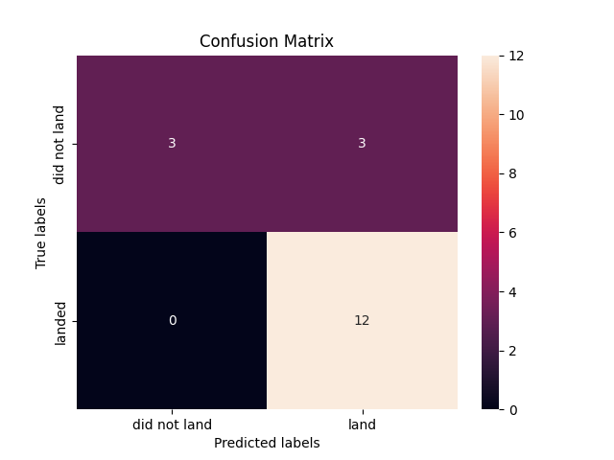
Results – Predictive Analysis (Classification)
Confusion Matrix
The confusion matrix is the same across all models.
The algorith models successfully predicted 12 successful outcomes, or true positives.
The algorith models successfully predicted 3 unsuccessful landings, or true negatives.
The algorith models unsuccessfully predicted 3 unsuccessful landings as successful landings, or false positives.
The models overpredict successful landings.
https://github.com/diogoolvra/IBMDSfilesdiogo/blob/main/Data%20Science%20and%20Machine%20Learning%20Capstone%20Project/Module%204%20-%20Predictive%20Analysis%20(Classification)/IBM-DS0321EN-SkillsNetwork_labs_module_4_SpaceX_Machine_Learning_Prediction_Part_5.jupyterlite.ipynb

Slide 41
05
Conclusions

Slide 42
Conclusions
Our task was to develop a machine learning model for SpaceY who wants to bid against SpaceX in rocket launches.
The goal of model is to predict when Stage 1 will successfully land to save ~$100 million USD.
Used data from a public SpaceX API and web scraping SpaceX Wikipedia page.
Created data labels and stored data into a DB2 SQL database.
Created a dashboard for visualization.
Created machine learning models using different algorithms, all with an accuracy of 83% on testing data.
Allon Mask of SpaceY can use this model to predict with relatively high accuracy whether a launch will have a successful Stage 1 landing before launch.
To get more definitive results, more data should be collected to better determine the best machine learning model and improve overall accuracy.

Slide 43
06
Appendix

Slide 44
Appendix
GitHub repository link:
https://github.com/diogoolvra/IBMDSfilesdiogo/tree/main/Data%20Science%20and%20Machine%20Learning%20Capstone%20Project

